Slide 1
JavaScript ES6 & Beyond
07 May 18 | Start
Appendix
Online

Slide 2
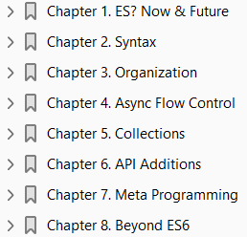
JavaScript ES6
Ch | Date
1 | 00 May 18
2
3
4
5
6
7
8
You Don’t Know JS - ES6 & Beyond 01 2016

Slide 3

1
ES? Now & Future

Slide 4
Intro
Before you dive into this book, you should have a solid working proficiency over JavaScript up to the most recent standard (at the time of this writing), which is commonly called ES5 (technically ES 5.1).
Here, we plan to talk squarely about the upcoming ES6, as well as cast our vision beyond to understand how JS will evolve moving forward.

Slide 5
Other JS Books
If you are still looking for confidence with JavaScript, I highly recommend you read the other titles in this series first:
Up & Going: Are you new to programming and JS?
This is the roadmap you need to consult as you start your learning journey.
Scope & Closures: Did you know that JS lexical scope is based on compiler (not interpreter!) semantics?
Can you explain how closures are a direct result of lexical scope and functions as values?
this & Object Prototypes: Can you recite the four simple rules for how this is bound?
Have you been muddling through fake “classes” in JS instead of adopting the simpler “behavior delegation” design pattern?
Ever heard of objects linked to other objects (OLOO)?
Types & Grammar: Do you know the built-in types in JS, and more importantly, do you know how to properly and safely use coercion between types?
How comfortable are you with the nuances of JS grammar/syntax?
Async & Performance: Are you still using callbacks to manage your asynchrony?
Can you explain what a promise is and why/how it solves “callback hell”?

Slide 6
Other JS Books |
Do you know how to use generators to improve the legibility of async code?
What exactly constitutes mature optimization of JS programs and individual operations?

Slide 7
Evolution of JS
If you’ve already read all those titles and you feel pretty comfortable with the topics they cover, it’s time we dive into the evolution of JS to explore all the changes coming not only soon but farther over the horizon.
Unlike ES5, ES6 is not just a modest set of new APIs added to the language.
It incorporates a whole slew of new syntactic forms, some of which may take quite a bit of getting used to.
There’s also a variety of new organization forms and new API helpers for various data types.
ES6 is a radical jump forward for the language.
Even if you think you know JS in ES5, ES6 is full of new stuff you don’t know yet, so get ready!
This book explores all the major themes of ES6 that you need to get up to speed on, and even gives you a glimpse of future features coming down the track that you should be aware of.

Slide 8
NOTE
All code in this book assumes an ES6+ environment.
At the time of this writing, ES6 support varies quite a bit in browsers and JS environments (like Node.js), so your mileage may vary.

Slide 9
Versioning
The JavaScript standard is referred to officially as “ECMAScript” (abbreviated “ES”), and up until just recently has been versioned entirely by ordinal number (i.e., “5” for “5th edition”).
The earliest versions, ES1 and ES2, were not widely known or implemented.
ES3 was the first widespread baseline for JavaScript, and constitutes the JavaScript standard for browsers like IE6-8 and older Android 2.x mobile browsers.
For political reasons beyond what we’ll cover here, the ill-fated ES4 never came about.
In 2009, ES5 was officially finalized (later ES5.1 in 2011), and settled as the widespread standard for JS for the modern revolution and explosion of browsers, such as Firefox, Chrome, Opera, Safari, and many others.
Leading up to the expected next version of JS (slipped from 2013 to 2014 and then 2015), the obvious and common label in discourse has been ES6.
However, late into the ES6 specification timeline, suggestions have surfaced that versioning may in the future switch to a year-based schema, such as ES2016 (aka ES7) to refer to whatever version of the specification is finalized before the end of 2016.
Some disagree, but ES6 will likely maintain its dominant mindshare over the late change substitute ES2015.
However, ES2016 may in fact signal the new year-based schema.
It has also been observed that the pace of JS evolution is much faster even than single-year versioning.

Slide 10
Versioning |
As soon as an idea begins to progress through standards discussions, browsers start prototyping the feature, and early adopters start experimenting with the code.
Usually well before there’s an official stamp of approval, a feature is de facto standardized by virtue of this early engine/tooling prototyping.
So it’s also valid to consider the future of JS versioning to be per-feature rather than per-arbitrary-collection-of-major-features (as it is now) or even per-year (as it may become).

Slide 11
Transpiling
Made even worse by the rapid evolution of features, a problem arises for JS developers who at once may both strongly desire to use new features while at the same time being slapped with the reality that their sites/apps may need to support older browsers without such support.
The way ES5 appears to have played out in the broader industry, the typical mindset was that code bases waited to adopt ES5 until most if not all pre-ES5 environments had fallen out of their support spectrum.
As a result, many are just recently (at the time of this writing) starting to adopt things like strict mode, which landed in ES5 over five years ago.
It’s widely considered to be a harmful approach for the future of the JS ecosystem to wait around and trail the specification by so many years.
All those responsible for evolving the language desire for developers to begin basing their code on the new features and patterns as soon as they stabilize in specification form and browsers have a chance to implement them.
So how do we resolve this seeming contradiction?
The answer is tooling, specifically a technique called transpiling (transformation + compiling).
Roughly, the idea is to use a special tool to transform your ES6 code into equivalent (or close!) matches that work in ES5 environments.

Slide 12
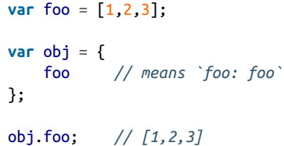
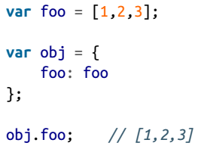
Example
For example, consider shorthand property definitions (see “Object Literal Extensions” on page 38 in Chapter 2).
Here’s the ES6 form:
But (roughly) here’s how that transpiles:
This is a minor but pleasant transformation that lets us shorten the foo: foo in an object literal declaration to just foo, if the names are the same.

Slide 13
Example
For example, consider shorthand property definitions (see “Object Literal Extensions” on page 38 in Chapter 2).
Here’s the ES6 form:
But (roughly) here’s how that transpiles:
This is a minor but pleasant transformation that lets us shorten the foo: foo in an object literal declaration to just foo, if the names are the same.
Transpilers perform these transformations for you, usually in a build workflow step similar to how you perform
Linting
Minification
other similar operations

Slide 14
Shims/Polyfills
Not all new ES6 features need a transpiler.
Polyfills (aka shims) are a pattern for defining equivalent behavior from a newer environment into an older environment, when possible.
Syntax cannot be polyfilled, but APIs often can be.

Slide 15
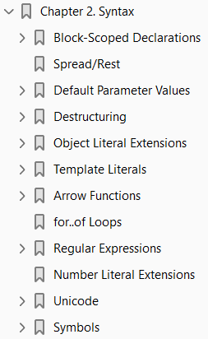
2
Syntax

Slide 16
Intro

Slide 17
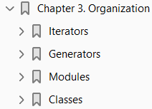
3
Organization

Slide 18
Intro

Slide 19

4
Async Flow Control

Slide 20
Intro

Slide 21
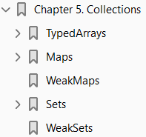
5
Collections

Slide 22
Intro

Slide 23
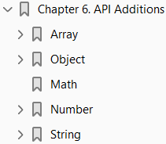
6
API Additions

Slide 24
Intro

Slide 25
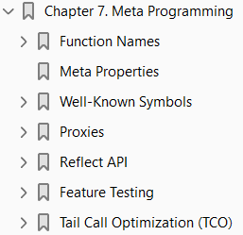
7
Meta Programming

Slide 26
Intro

Slide 27
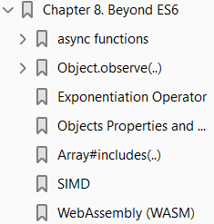
8
Beyond ES6

Slide 28
Intro

